Slide 1
Deep learning-based search engine for biomedical images using convolutional neural networks
Goal: Elevating query mismatch issue by improving search engine querying. Innovation: Construct vector space based on image features derived from a CNN. What did they do?
Acquired feature vectors with CNN to each class and image.
Used vector space to perform similarity measurement between input vector and class vectors to determine input label.
Used similarity measurement between input vector and dataset vectors to determine retrieved image index.

Slide 2
Deep learning-based search engine for biomedical images using convolutional neural networks
Goal: Elevating query mismatch issue by improving search engine querying. Innovation: Construct vector space based on image features derived from a CNN. What did they do?
Acquired feature vectors with CNN to each class and image.
Used vector space to perform similarity measurement between input vector and class vectors to determine input label.
Used similarity measurement between input vector and dataset vectors to determine retrieved image index.

Slide 3
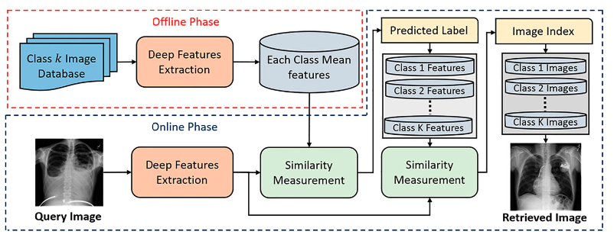
Deep learning-based search engine for biomedical images using convolutional neural networks
Goal: Elevating query mismatch issue by improving search engine querying. Innovation: Construct vector space based on image features derieved from a CNN. What did they do?
Acquired feature vectors with CNN to each class and image.
Used vector space to perform simillarity measurment between input vector and class vectors to determine input label.
Used simillarity simillarity measurment between input vector and dataset vectors to determine retrived image index.

Slide 4
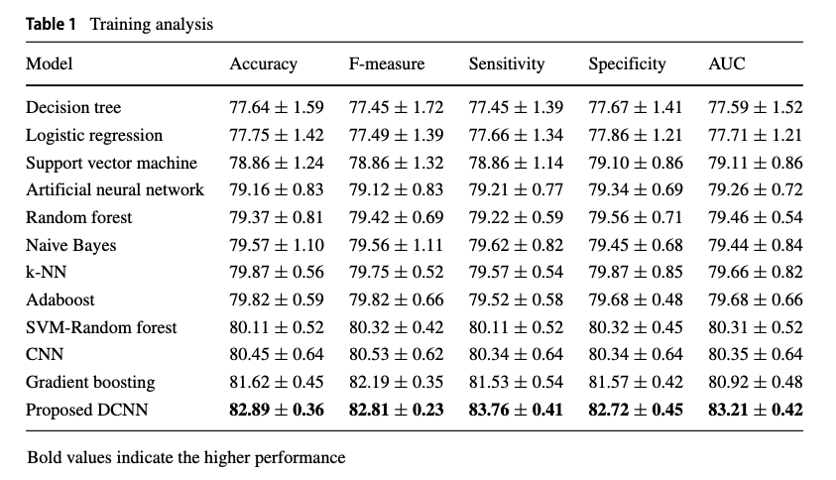
Deep learning-based search engine for biomedical images using convolutional neural networks
Results:

Slide 5
Text-guided visual representation learning for medical image retrieval systems
Goal: Improving image retrieval in heath care systems. Innovation: Used “dormant” data from medical resources to improve image representation. What did they do?
Adopted textual data to convey additional semantic information on images.
Used CLIP architecture with modified pretrained in-domain image encoder (Clinical BERT).
Training phase included contrastive learning between images and their captions.

Slide 6
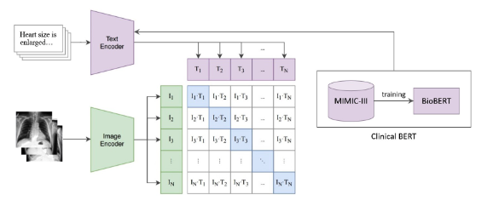
Text-guided visual representation learning for medical image retrieval systems
Goal: Improving image retrieval in heath care systems. Innovation: Used “dormant” data from medical resources to improve image representation. What did they do?
Adopted textual data to convey additional semantic information on images.
Used CLIP architecture with modified pretrained in-domain image encoder (Clinical BERT).
Training phase included contrastive learning between images and their captions.

Slide 7
Text-guided visual representation learning for medical image retrieval systems
Results : Authors created a custom data set from ROCO –
Mapped images to labels by mapping CUI to SemTypes in UMLS library.
Created a custom data set by using only images with SemTypes “Diagnostic procedure”, “Body part, Organ”.
Retrieval evaluation data set with an expert annotations from Doctors.
Precision @ K (number of images).

Slide 8
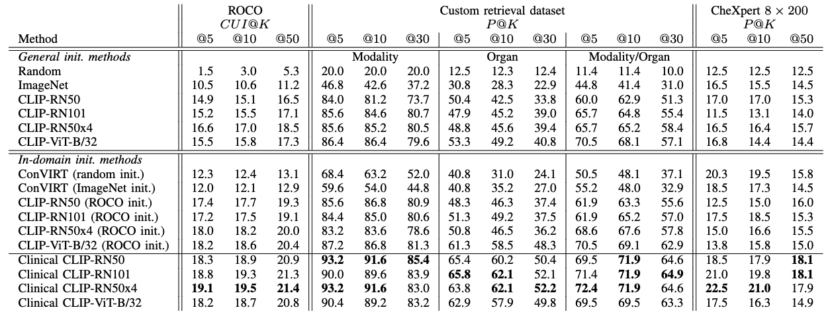
Text-guided visual representation learning for medical image retrieval systems
Results : Authors created a custom data set –
Mapped images to labels by mapping CUI to SemTypes in UMLS library.
Created a custom data set by using only images with SemTypes “Diagnostic procedure”, “Body part, Organ”.
Retrieval evaluation data set with an expert annotations from Doctors.
Precision @ K (number of images).

Slide 9
LILE: Look In-Depth before Looking Elsewhere – A Dual Attention Network using Transformers for Cross-Modal Information Retrieval in Histopathology Archives
Goal: Improving image retrieval in heath care systems. Innovation: Iterative Architecture to represent different modalities in the same latent space. What did they do?
Added another modality (text) to capture related information to data.
Added self attention layers as an additional loss term.
Created feature representation from input images (VIT) and text (ROBERTA).
Self attention layers to extract most significant features of each modality.
Cross attention module to refine representation with regards to second modality.

Slide 10
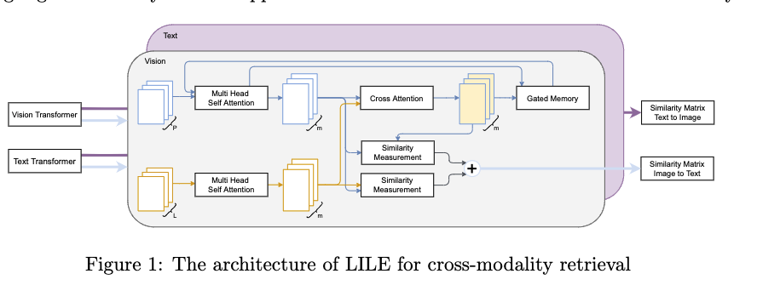
LILE: Look In-Depth before Looking Elsewhere – A Dual Attention Network using Transformers for Cross-Modal Information Retrieval in Histopathology Archives
Goal: Improving image retrieval in heath care systems. Innovation: Iterative Architecture to represent different modalities in the same latent space. What did they do?
Added another modality (text) to capture related information to data.
Added self attention layers as an additional loss term.
Created feature representation from input images (VIT) and text (ROBERTA).
Self attention layers to extract most significant features of each modality.
Cross attention module to refine representation with regards to second modality.

